Slide 1
Equipment Tracker
Thomas Smiley

Slide 2

Problem Statement
Managing equipment and resources in a company is a very difficult task. Often the equipment is bought by the company for permanent use or rented for temporary use. There are also subcomponent modules which are bought and built into a product and sold. Tracking where all this equipment is or who is using it in one location does not exist to the extent that is needed. Often equipment is lost or unknowingly needed by multiple people at the same time. This leads to company downtime and annoying periods of unproductivity due to equipment mismanagement.

Slide 3
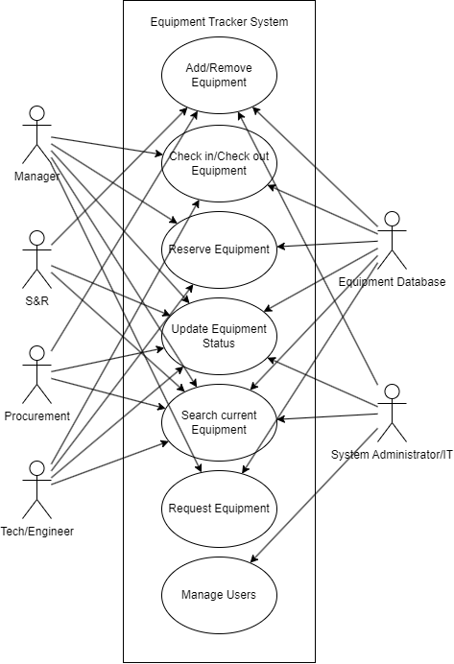

Slide 4
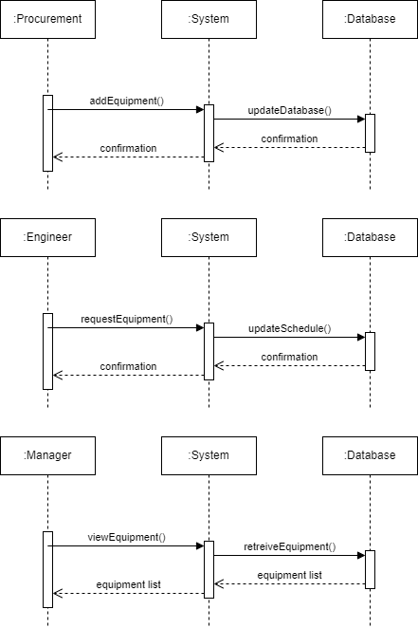
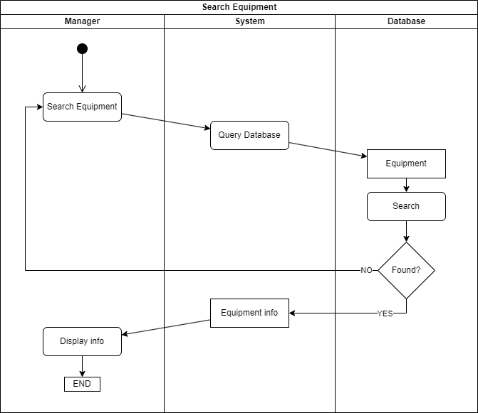

Slide 5
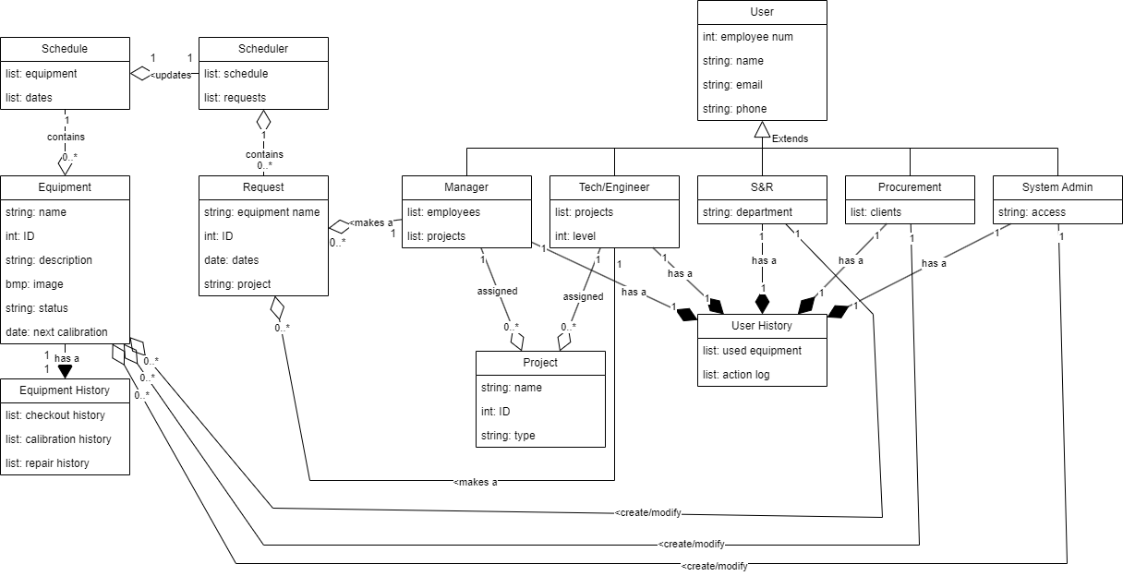

Slide 6
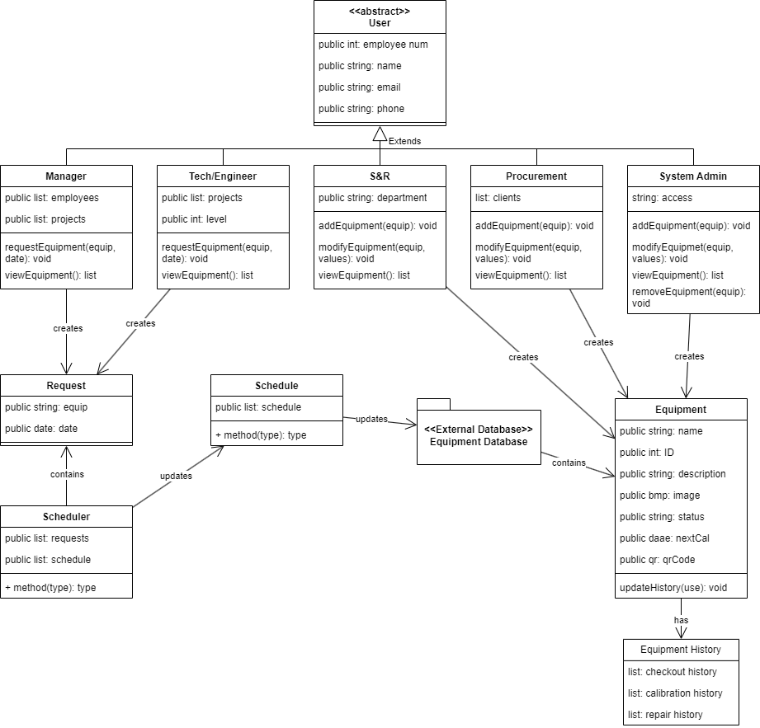

Slide 7
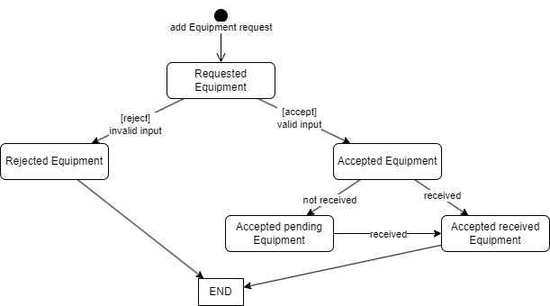

Slide 8
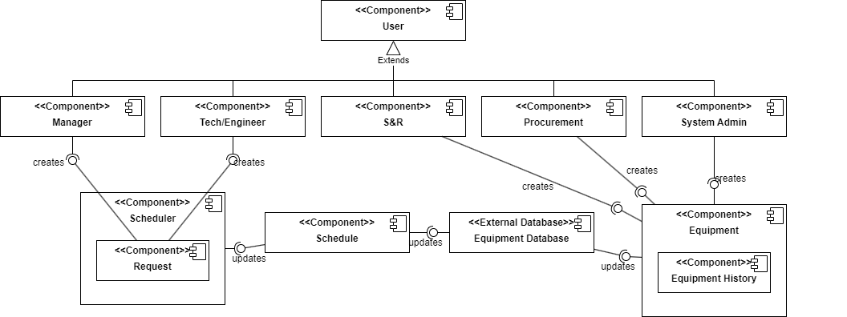

Slide 9
Design Principles
SRP
DRY
Polymorphism
Cloud Native

Slide 10
Conclusion
Takeaways
Skills learned

